Slide 1
Introduction To DSAA + Linear & Binary Search
DSAA Section E & F
Fatima Khan

Slide 2
01
02
03
Bubble Sort
Insertion Sort
Selection Sort
Works by repeatedly swapping the adjacent elements
Works by iteratively inserting each element of an unsorted list into its correct position in a sorted portion of the list
It repeatedly selects the smallest (or largest) element from the unsorted part & swapping it with the first unsorted element

Slide 3
Bubble Sort
Bubble Sort is the simplest sorting algorithm that works by repeatedly swapping the adjacent elements if they are in the wrong order. This algorithm is not suitable for large data sets as its average and worst-case time complexity are quite high.
Time Complexity: O(n²)

Slide 4
How Bubble Sort Works
We sort the array using multiple passes. After the first pass, the maximum element goes to end (its correct position). Same way, after second pass, the second largest element goes to second last position and so on.
In every pass, we process only those elements that have already not moved to correct position. After k passes, the largest k elements must have been moved to the last k positions.
In a pass, we consider remaining elements and compare all adjacent and swap if larger element is before a smaller element. If we keep doing this, we get the largest (among the remaining elements) at its correct position.

Slide 5
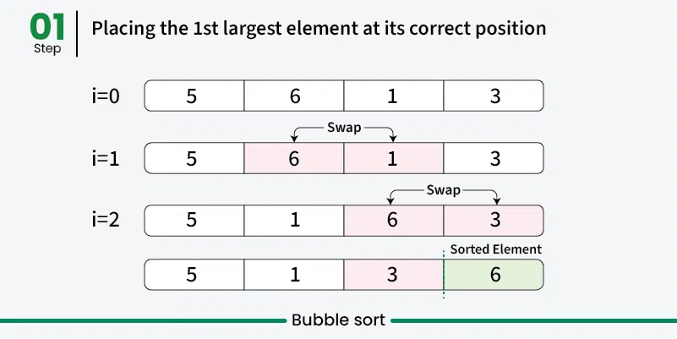
How Bubble Sort Works

Slide 6
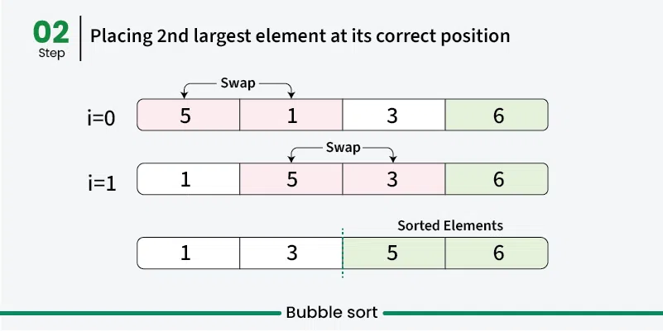
How Bubble Sort Works

Slide 7
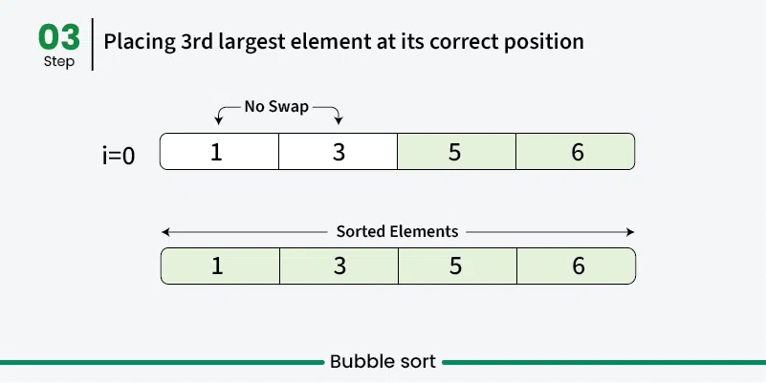
How Bubble Sort Works

Slide 8
PROS & CONS OF BUBBLE SORT
Advantages
Disadvantages
1. Easy to understand and implement.
2. Doesn’t require any additional memory space.
3. It is a stable sorting algorithm.
Time complexity of O(n²)
Very slow for large data sets.

Slide 9
Insertion Sort
It is a simple sorting algorithm that works by iteratively inserting each element of an unsorted list into its correct position in a sorted portion of the list. It is like sorting playing cards in your hands. You split the cards into two groups: the sorted cards and the unsorted cards. Then, you pick a card from the unsorted group and put it in the right place in the sorted group.
Time Complexity: O(n²)

Slide 10
How Insertion Sort Works
We start with the second element of the array as the first element is assumed to be sorted.
Compare the second element with the first element if the second element is smaller then swap them.
Move to the third element, compare it with the first two elements, and put it in its correct position
Repeat until the entire array is sorted.

Slide 11
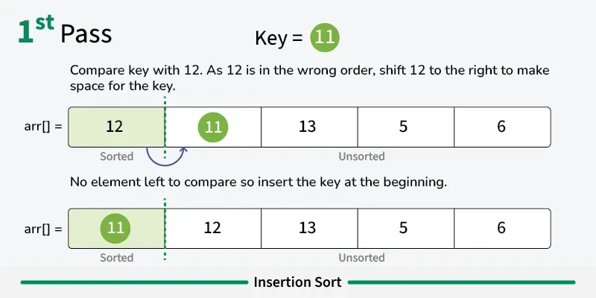
How Insertion Sort Works

Slide 12
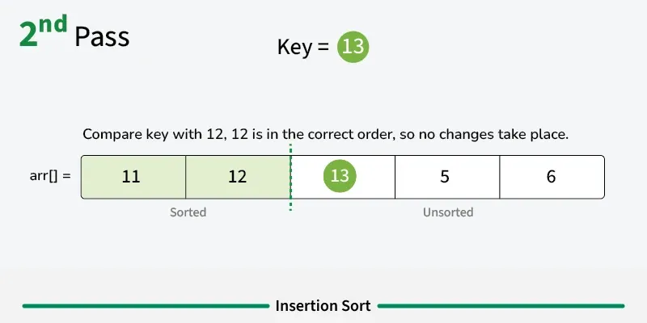
How Insertion Sort Works

Slide 13
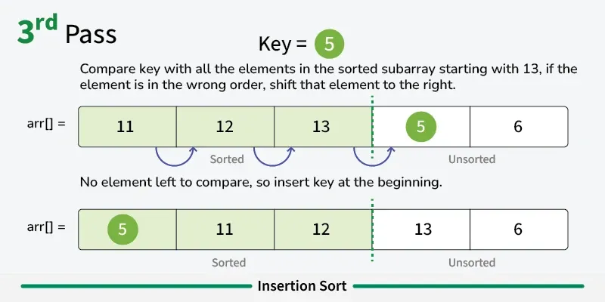
How Insertion Sort Works

Slide 14
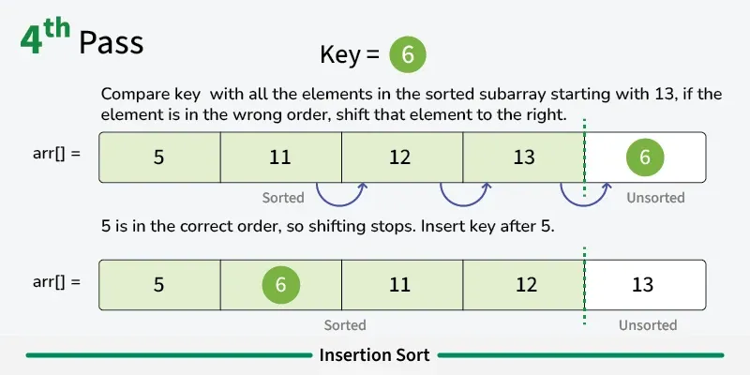
How Insertion Sort Works

Slide 15
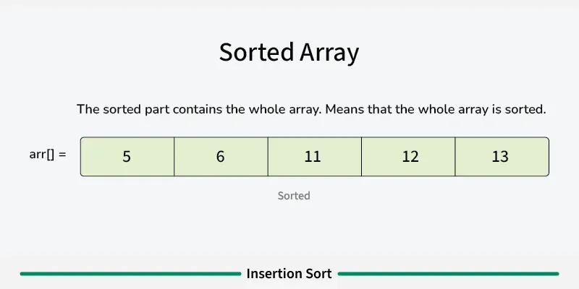
How Insertion Sort Works

Slide 16
PROS & CONS OF INSERTION SORT
Advantages
Disadvantages
Simple and easy to implement.
Stable sorting algorithm.
Efficient for small lists and nearly sorted lists.
Space-efficient as it is an in-place algorithm.
Adoptive. the number of inversions is directly proportional to number of swaps. For example, no swapping happens for a sorted array and it takes O(n) time only.
Inefficient for large lists.
Not as efficient as other sorting algorithms (e.g., merge sort, quick sort) for most cases.

Slide 17
Selection Sort
Selection Sort is a comparison-based sorting algorithm. It sorts an array by repeatedly selecting the smallest (or largest) element from the unsorted portion and swapping it with the first unsorted element. This process continues until the entire array is sorted.
Time Complexity: O(n²)

Slide 18
How Selection Sort Works
First we find the smallest element and swap it with the first element. This way we get the smallest element at its correct position.
Then we find the smallest among remaining elements (or second smallest) and swap it with the second element.
We keep doing this until we get all elements moved to correct position.

Slide 19
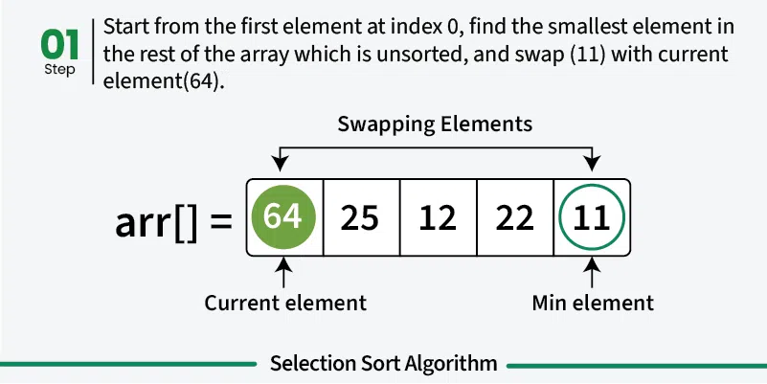
How Selection Sort Works

Slide 20
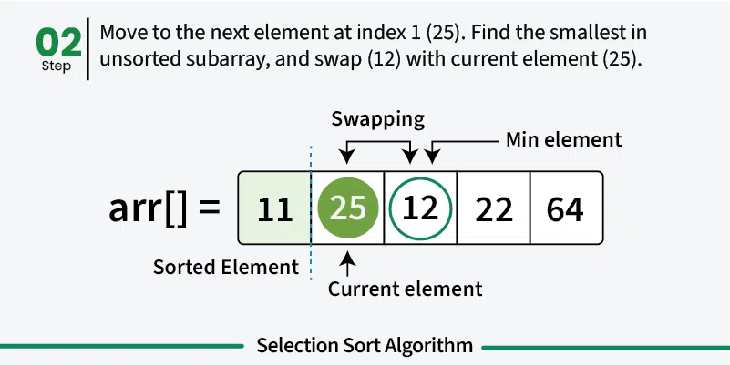
How Selection Sort Works

Slide 21
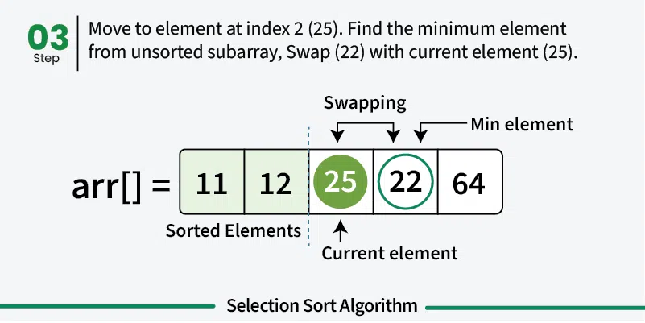
How Selection Sort Works

Slide 22
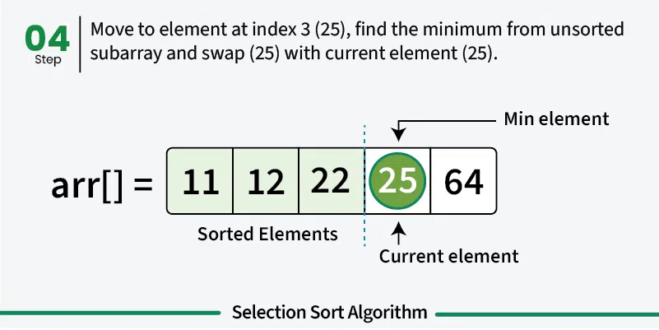
How Selection Sort Works

Slide 23
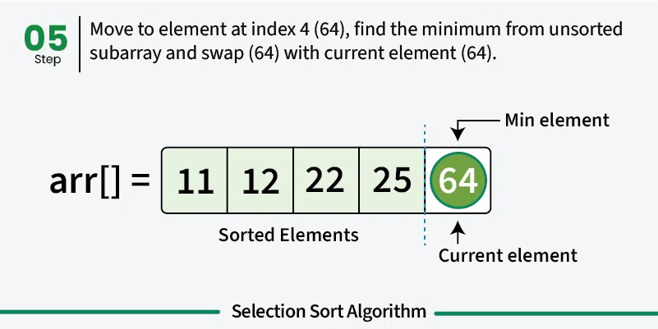
How Selection Sort Works

Slide 24
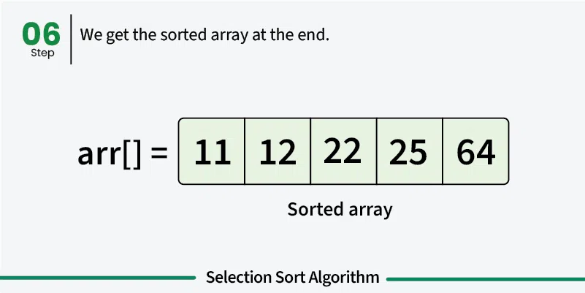
How Selection Sort Works

Slide 25
PROS & CONS OF SELECTION SORT
Advantages
Disadvantages
Easy to understand and implement.
Requires only a constant O(1) extra memory space.
It requires less number of swaps (or memory writes) compared to many other standard algorithms.
Selection sort has a time complexity of O(n^2) makes it slower compared to algorithms like Quick Sort or Merge Sort.
Does not maintain the relative order of equal elements which means it is not stable.

